Slide 1


Ninja Pursuit
By David Harish Alwyn

Slide 2

Story
Ninja Hiro searches for a secret library of science, medicine, and technology in a post-apocalyptic world. He faces danger from enemies who seek to destroy technology. Hiro uses his ninja skills to reach the library and protect valuable knowledge, facing increasingly difficult challenges along the way.

Slide 3



GAMEPLAY
Genre
Platform
2D casual game
Mobile/Smart phones

Slide 4

Controls
Obstacles
One click
Spiked pits
Throwing stars
Fire obstacles
Poisoned darts

Slide 5



Extra Features
MONETIZATION
Advertisements
Coins
Limited skin pack

Slide 6

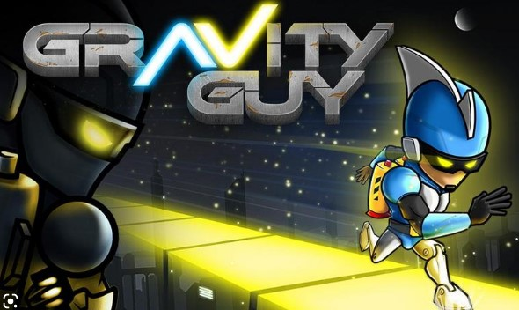
Inspirations
Jetpack Joyride
Gravity Guy

Slide 7

Thank You!

